Slide 1



Crop Disease Detection Using Image Processing Using Python
Automated Computer Vision & Deep Learning Framework for Smart Agriculture SUBJECT CODE
CSA0801
Presented by
GOKUL K 1911260026
TAMIZHARASAN 1911260080
DHANANJAYAN1921260038
FACULTY
Dr SAMASON EBENEZAR

Slide 2
Introduction
•
A Python-based application utilizing computer vision to detect crop leaf ailments early.
•
Processes digital leaf images captured from farms using standard cameras or mobile devices.
•
Applies image conversion, filtering, and thresholding using Python's OpenCV library.
•
Utilizes Machine Learning / Deep Learning algorithms to recognize infection symptoms automatically.
•
Calculates infection severity and delivers actionable disease diagnosis to farmers.
•
Extensible towards web dashboards (Streamlit) and mobile/drone field monitoring solutions.

Slide 3






Objectives & SDG Alignment
Early Diagnosis
SDG 2: Zero Hunger
SDG 15: Life on Land
Build an accurate Python workflow to automatically spot fungal, bacterial, and viral leaf infections prior to crop devastation.
Protects food production and maximizes yield quality by enabling timely pesticide application and preventing crop loss.
Promotes sustainable farming by reducing unnecessary chemical overuse through target-specific disease detection.

Slide 4
Literature Review
S.No | Research Paper Title | Authors | Advantages | Technologies Used
1 | Plant Leaf Disease Detection using Deep Learning | Mohanty et al. (2016) | High classification accuracy (99.35%) across 14 crop species. | CNN, PlantVillage Dataset, TensorFlow
2 | Review on Emerging Trends in Plant Disease Detection | Kartikeyan & Shrivastava (2021) | Comprehensive study on color texture features and classifiers. | Digital Image Processing, SVM, KNN
3 | Crop Disease Detection using Image Processing & CNN | Thushar et al. (2022) | Automated segmentation and feature extraction for field images. | Python, OpenCV, K-Means Clustering
4 | Leaf Disease Recognition Using Deep Learning | Joseph et al. (2024) | Real-time edge device capability and augmentation techniques. | PyTorch, Transfer Learning, MobileNet

Slide 5

System Methodology
2. Preprocessing
4. Classification
Resizing images, Gaussian blurring for noise removal, and HSV color transformation.
Passing features through trained Python model to identify disease type & recommend treatment.
1. Image Acquisition
3. Feature Extraction
Capturing infected crop leaf samples and loading PlantVillage dataset via Python PIL/OpenCV.
Segmenting diseased spots using thresholding and extracting texture (GLCM) or CNN feature maps.

Slide 6


System Architecture
Input & Preprocessing Pipeline
Feature & Diagnosis Engine
User / Field Camera: Captures image of diseased leaf.
Segmentation Module: Isolates infected lesion regions from healthy green background.
Image Storage: Uploaded directly or pulled from database.
OpenCV Engine: Performs cropping, noise reduction, color space conversion (RGB to HSV), and green mask masking.
Model Inference: Runs deep CNN model / SVM classifier.
Result & Solution Module: Displays disease name, confidence score, and suggested treatment.

Slide 7
Module 1: Preprocessing
Image Acquisition & Enhancement
Image Resizing: Standardizes input photos to 224x224 dimensions for model input uniformity.
Denoising: Applies Gaussian and Median Filtering in OpenCV to remove background noise.
Color Conversion: Transforms standard BGR color space to HSV to isolate lesion shades efficiently.

Slide 8
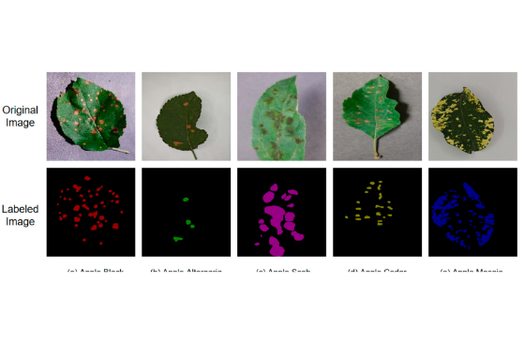
Module 2: Segmentation
Leaf Segmentation & Feature Extraction
Otsu's Thresholding: Automatically sets threshold values to separate infected spots from healthy leaf tissue.
K-Means Clustering: Groups pixels into clusters based on color hue to identify infected areas clearly.
Texture Extraction: Computes GLCM features (Contrast, Homogeneity, Energy, and Correlation) in Python.

Slide 9


Module 3: Model Training
Convolutional Neural Network (CNN)
Machine Learning Classifiers
Architecture: Multiple Convolutional, ReLU, MaxPooling, and Dense layers built using TensorFlow / Keras.
Scikit-Learn SVM: Trains Support Vector Machines using extracted GLCM texture and color histogram features.
Augmentation: Applies rotation, horizontal flipping, and zoom shifts to prevent overfitting on farm photos.
Cross Validation: Evaluates dataset splits (80% training, 20% testing) to ensure high generalizability.

Slide 10
Module 4: Disease Diagnosis
Disease Identification: Classifies diseases like Early Blight, Late Blight, Black Rot, Powdery Mildew, and Leaf Spot.
Severity Score: Calculates percentage of infected leaf surface area using contour area analysis.
Remedy Advisor: Recommends tailored chemical sprays, organic bio-pesticides, or agricultural practices.
Automated Report: Generates a summary diagnosis printable for farmers and agricultural experts.

Slide 11



Implementation Stack
Core Language
Computer Vision
AI Frameworks
Python 3.10+ providing robust scientific computing, concise syntax, and extensive computer vision packages.
OpenCV & PIL for image read, resize, color conversion, contour extraction, and thresholding operations.
TensorFlow, Keras, Scikit-Learn, NumPy for deep learning model training, matrix math, and feature evaluation.

Slide 12
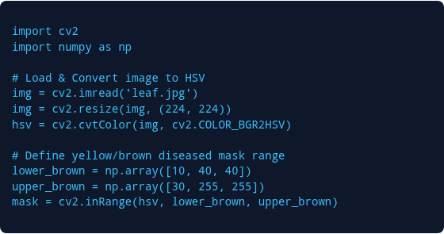
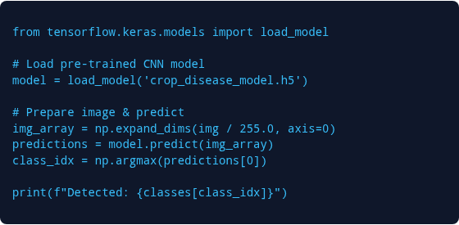
Source Code Highlights
Preprocessing & Masking
Model Inference & Output

Slide 13
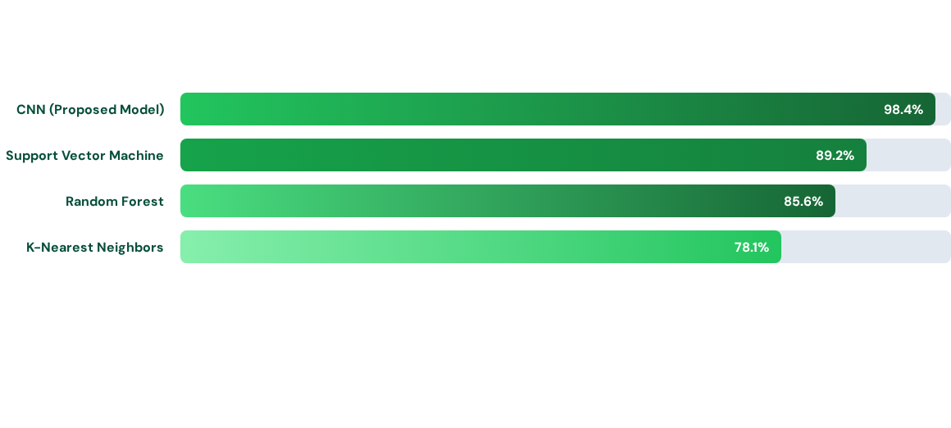
Results & Performance
The CNN model achieved superior performance with 98.4% accuracy across PlantVillage multi-crop dataset, outperforming traditional machine learning algorithms.

Slide 14


Future Scope
Mobile Application
Drone Integration
Cloud Dashboard
Deploy model via TensorFlow Lite into an Android/iOS mobile application for instant field offline diagnosis.
Attach camera module to agricultural drones for automated aerial monitoring over large crop fields.
Build cloud-connected database tracking disease outbreaks geographically and advising local farming communities.

Slide 15
Conclusion
Developed a functional and automated Crop Disease Detection Application in Python.
Successfully processes leaf images using OpenCV for noise reduction and color segmentation.
Achieved high classification accuracy using deep learning architectures on infected plant samples.
Supports sustainable agricultural practices by facilitating targeted disease treatments.
Demonstrates the practical integration of Python image processing libraries in modern computer vision systems.

Slide 16
Key References
Mohanty, S. P., Hughes, D. P., & Salathé, M. (2016). Using Deep Learning for Image-Based Plant Disease Detection. Frontiers in Plant Science, 7, 1419.
Kartikeyan, P., & Shrivastava, G. (2021). Review on Emerging Trends in Detection of Plant Diseases using Image Processing with Machine Learning. IJCA, 174(11), 39-48.
Thushar, B., et al. (2022). Crop Disease Detection Using Image Processing Technique and CNN Networks. Medium Research Series.
Joseph, A., Patil, S., & More, R. (2024). Image-Based Crop Disease Detection Using Machine Learning and Computer Vision. ResearchGate Publications.

Slide 17
Thank You!
Crop Disease Detection System | CSA0801 Project

